Slide 1
ALARM CLOCK

Slide 2
Project Description
This project is basically an alarm clock for mobile phones by means of software.
The purpose of this software is to provide an easy way to set the alarm. This software gives an upper hand to the old people or the people who don’t really have much knowledge about using smart phones.
This software facilitates easy access to set the alarm. The software has a small database pertaining to information about the location and time. The alarm details include hours, minutes, AM/PM, days of the week, etc.
The user can view the time again to recheck it after setting the alarm.

Slide 3
Scope
The users can easily access the app without any complications and difficulties.
The software provides the following facilities to the users:
Facilitates easy access and use.
Provides information about the time zones.
The objective of this software is to provide easy assistance to both the old as well as the beginners in smart phone use with proper database and information.

Slide 4
Working
The software provides good graphical user interface on the front end and a good informative interface on the rear end.
The system uses 3 main sections:
Set Alarm section:
This section further consists of three parts
Hours
The user needs to first set the hour.
Minutes
The user then needs to set the minutes.
AM/PM
After setting the hours and minutes, the user should set the AM/PM.

Slide 5
Reconfirm section:
A new user can go through the time once again before clicking on the ‘set alarm’ option.
Cancel Alarm section:
The user can also cancel the alarm before setting it.

Slide 6
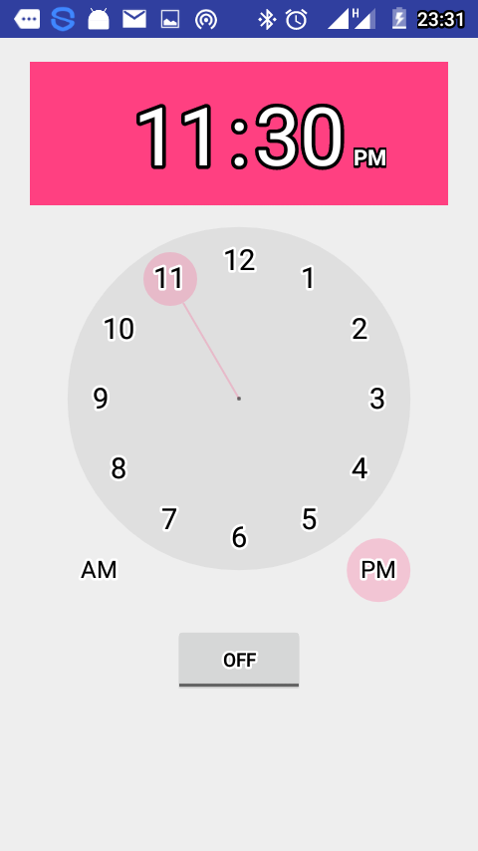
Screenshots

Slide 7
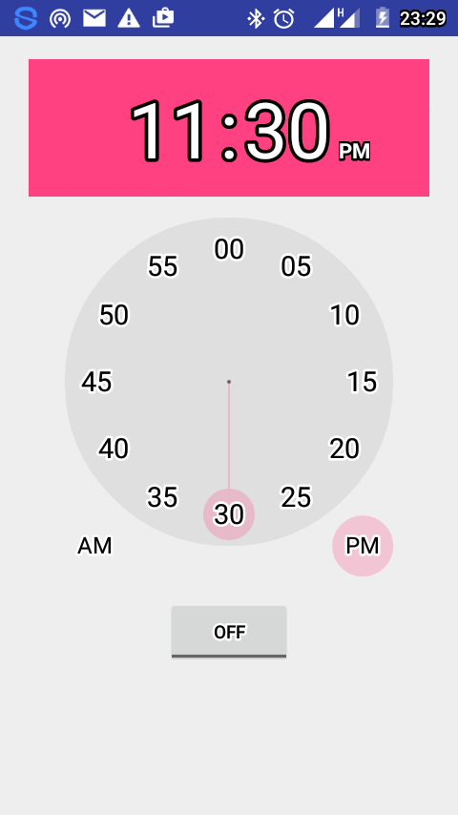
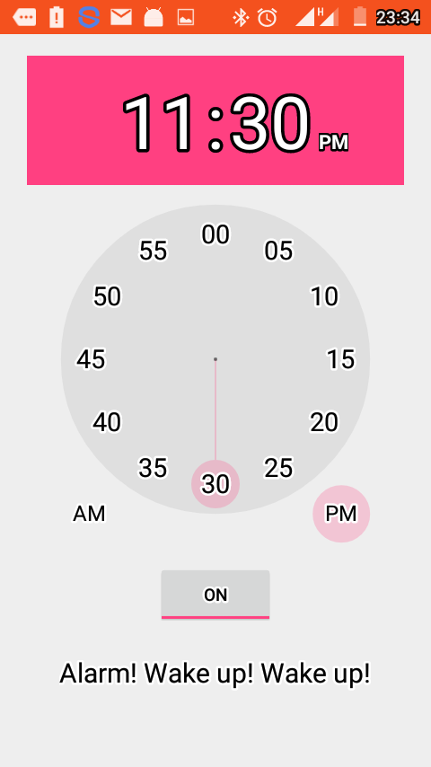

Slide 8
Conclusion
This project acts as an initiative to facilitate old people and less knowledgeable people use the alarm option built in a simple way.
Various open tools have been used effectively throughout the development of this software which made us explore the wide range of open tools available on the internet and their significance for the users especially for the aspired start-ups.
From this Project we understand how to create effectively an Interface between the Front End (Visual Basic) and the Back End (Database) wherein we develop an application for alarm clock using various parameters.

